Slide 1

Project 2 Supervised Learning IE 6910 Python ML
Mohammed Abdul Najeeb Farooqui
Parthiva Mondrety
Kush Modi

Slide 2
Regression Task

Slide 3
Data Description

Slide 4
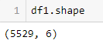
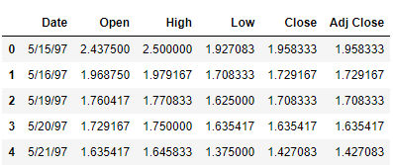
Historical data of Amazon Stock Market.
Shape of the data.
An overview of the data.

Slide 5
Time Series Analysis

Slide 6
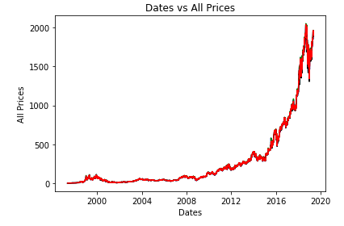
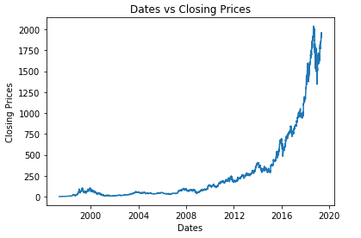
Time Series Analysis of Amazon Stock Data
Amazon’s Stock price has been on the rise since the beginning.
Reached the highest stock value in the year 2018.
A small aberration after the year 2018 where there was a small decline.
Stock prices increasing after 2019.

Slide 7
Statistical Summary

Slide 8
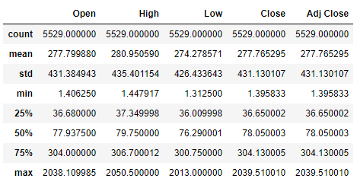
Brief Statistical Summary of the Dataset
Summary statistics are used to analyze a set of observations in order to obtain and perceive a large amount of data in a simple and easy manner.
It provides various parameters like the mean, standard deviation, different types of quartiles and the minimum and maximum values.
The column “Adj Close” can be dropped as it is identical to “Close” column.

Slide 9
Feature Engineering

Slide 10
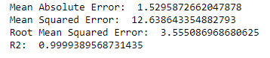
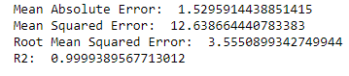
Feature Analysis
We aim to estimate the closing price of the day.
We first consider the features opening price, high price and low price of the day.
Simple Linear Regression Loss function Values.
Linear Regression with Ridge smoothing Loss function values.

Slide 11
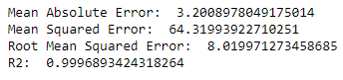
Linear Regression with Lasso smoothing Loss function values.
The R2 values are very similar and nearly equal to 1.
The data might have been over fitted.
In order to get better predictions in future, we create new columns.

Slide 12
Model Creation

Slide 13
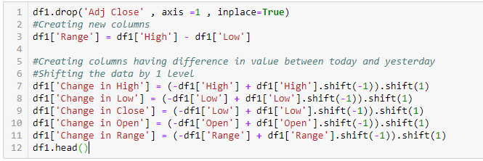
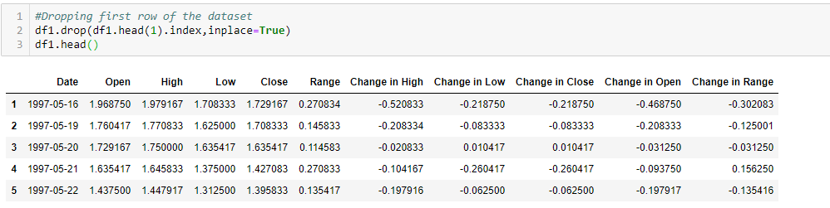
Creating new columns from existing ones.

Slide 14
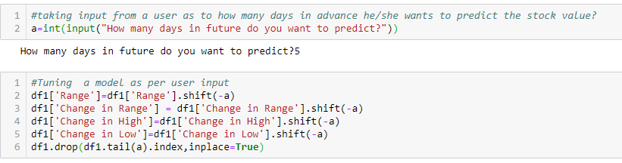
Tuning the model as per user input

Slide 15
Creating regression model

Slide 16
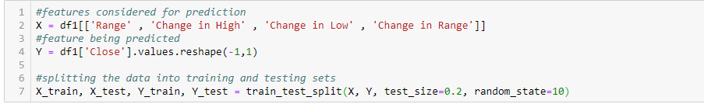
Features considered to create the model
Predicting Closing price of amazon stock based on the difference of range, change in low price, change in high price and change in range of two consecutive days .
Range is the difference between the high price and the low price of the day.

Slide 17
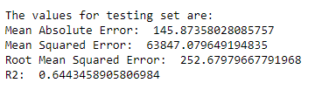
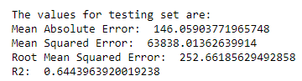
By running this model, we get the following loss function values.
Simple Linear Regression Loss function Values.
Linear Regression with Ridge smoothing Loss function values.

Slide 18
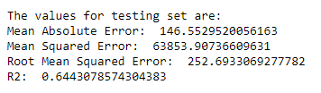
Linear Regression with Lasso smoothing Loss function values.
The R2 values are very similar but we can observe that Ridge regression has slightly better results when compared to other both.
Ridge performs better when the features are closely related to the dependent variable and hence in this case we can conclude that ridge regression gives the better results than lasso.
Lasso gives better predictions when we have a huge number of independent variables with many random features which do not effect the dependent variable.

Slide 19
Sensitivity analysis

Slide 20
Definition
Sensitivity analysis is a method which can be applied for predicting the outcome of a decision if a situation turns out to be different compared to the key predictions.
Helps in identifying how dependent the output is on an input value.
Accuracy keeps decreasing as we increase the test data size.

Slide 21
Classification Task

Slide 22
Data Description

Slide 23
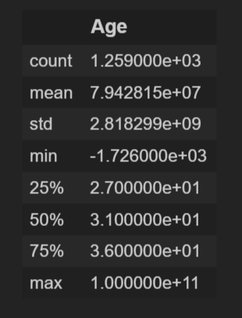
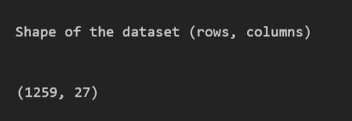
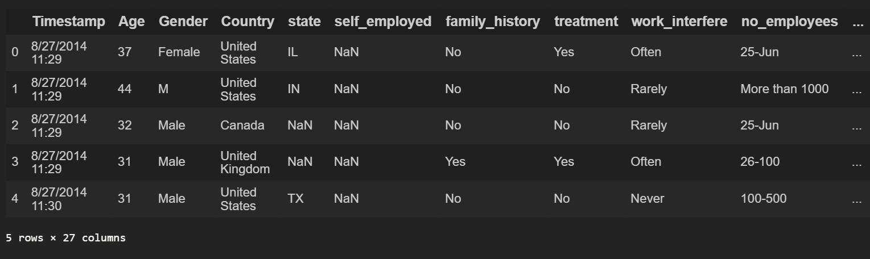
Shape of the dataset
Data Description
We have only age as the numeric value column, so we get only the statistical summary of one column in the dataset
Overview of the dataset

Slide 24
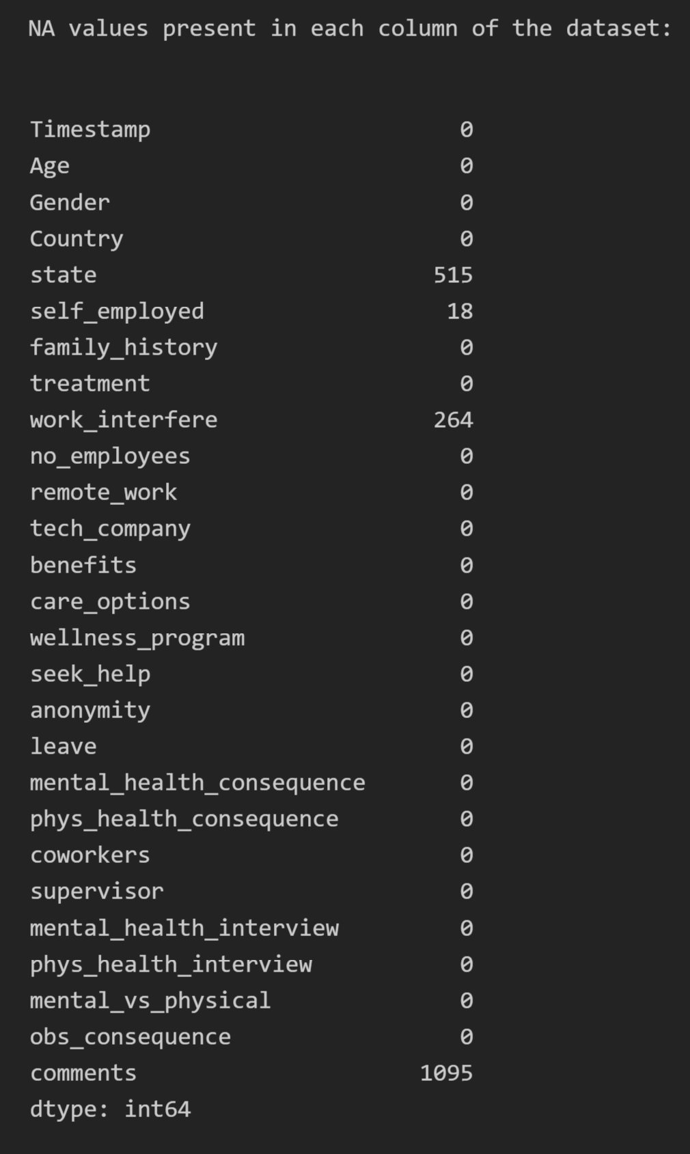
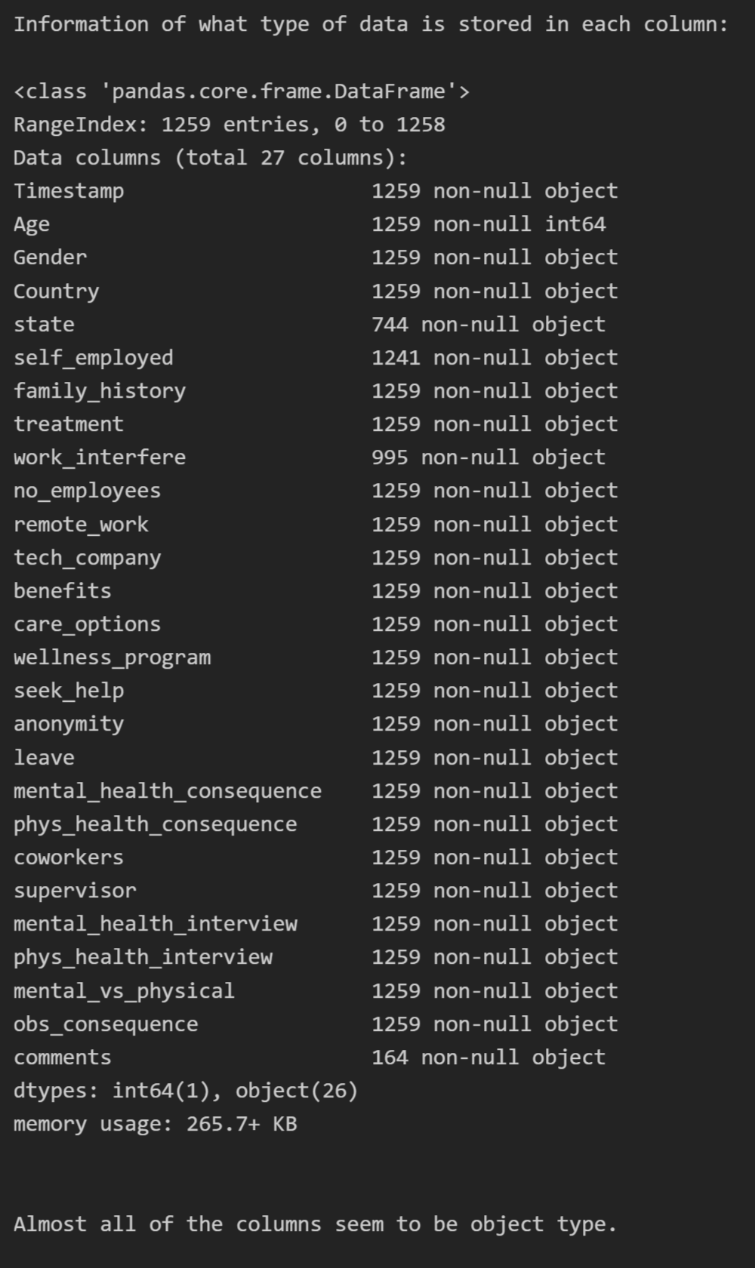
Missing Values counts
Information of the type of data stored in each column
We can see that state and work interfere have the most missing values in the data set
Almost all the data types seems to be of the type object.

Slide 25
Data Analysis

Slide 26
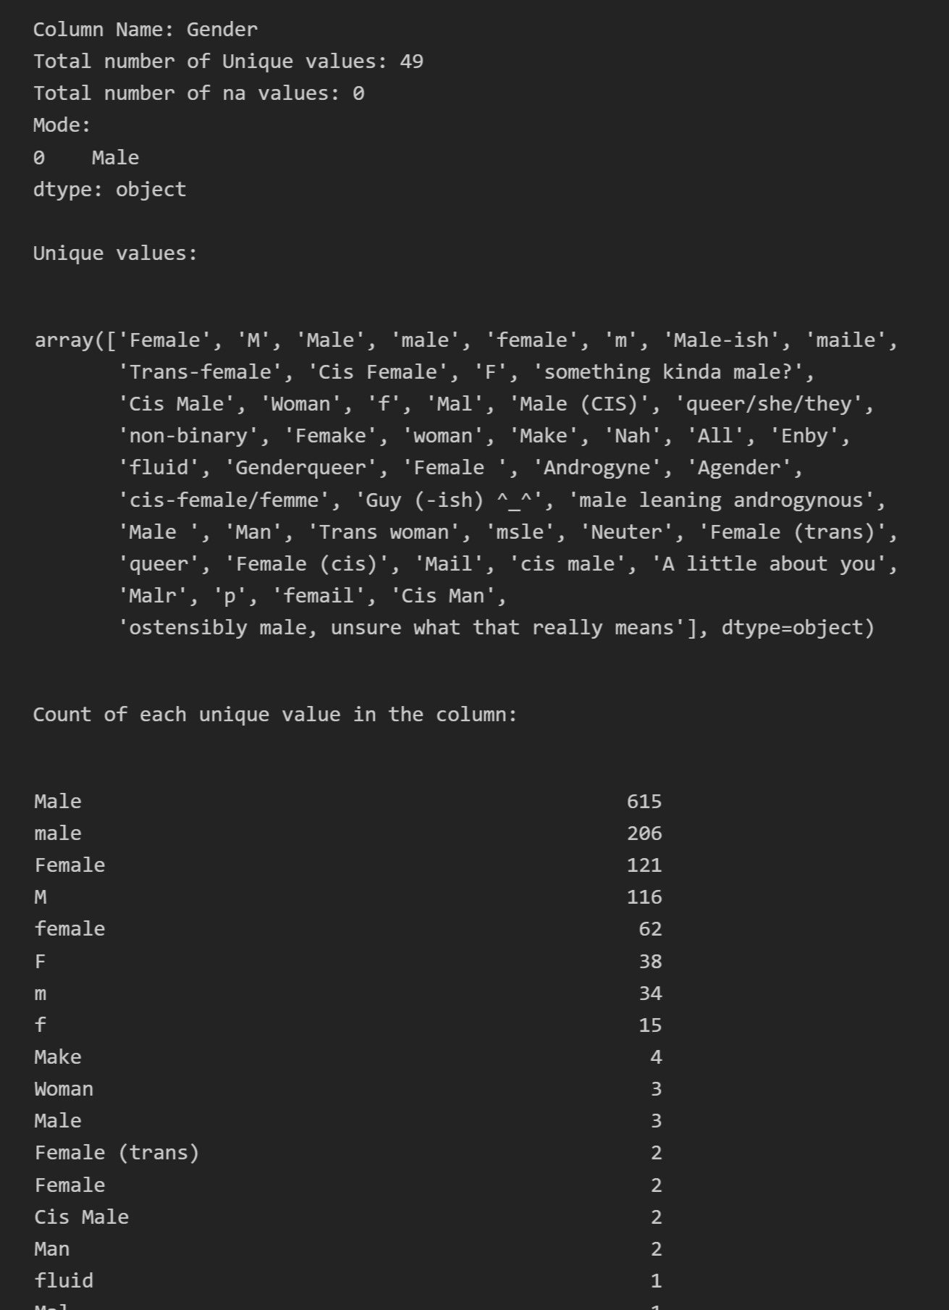
In Depth analysis of each column within the dataset
We look at each of the following value fields for all the columns present in our dataset
Column Name
Total Number of Unique Values
Number of NA values
Mode of the column
Unique Values Present
Value counts of each unique value

Slide 27
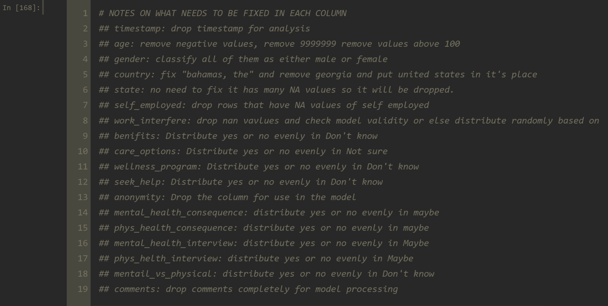
Based on our analysis we decide on how to handle the values in each column.

Slide 28
Data Transformation

Slide 29
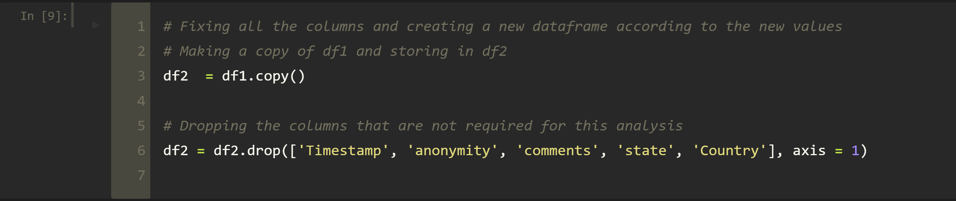
Examples of data transformations done on the data
Dropping columns like timestamp, anonymity, comments, state and country that are not required for our analysis.

Slide 30
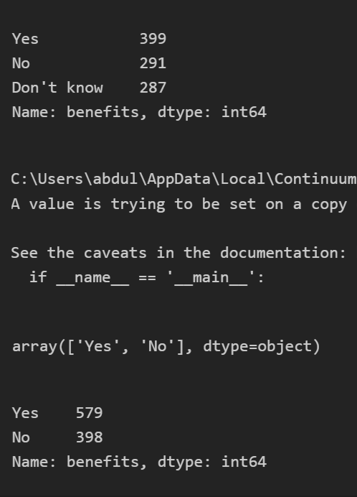
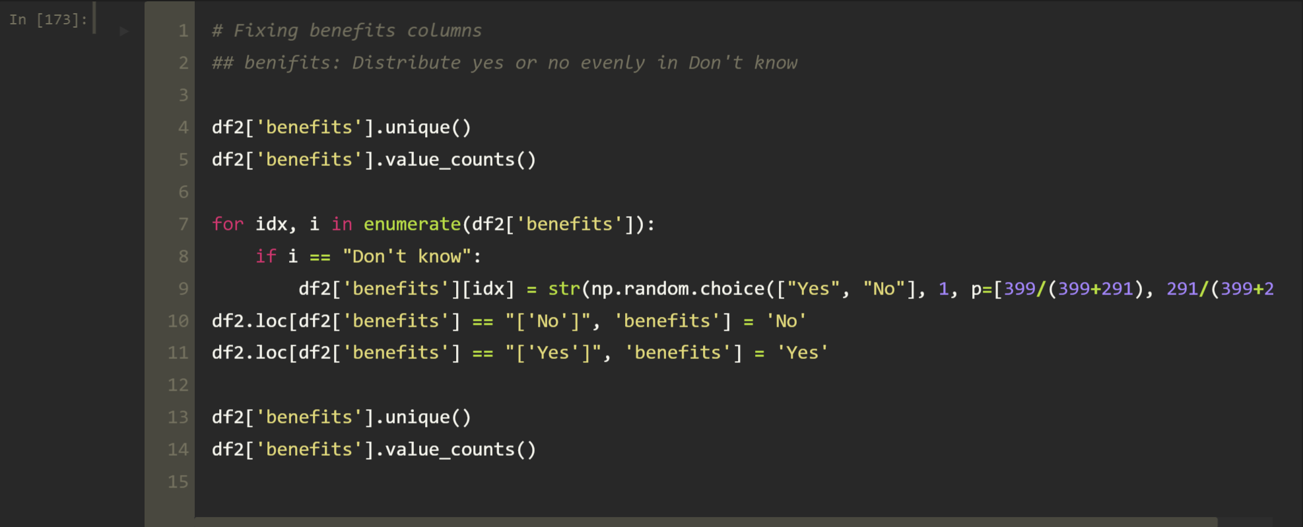
Benefits Column
We calculate the proportion of yes or no in the benefits column
This proportion is used to fill the DON”T KNOW in the column

Slide 31
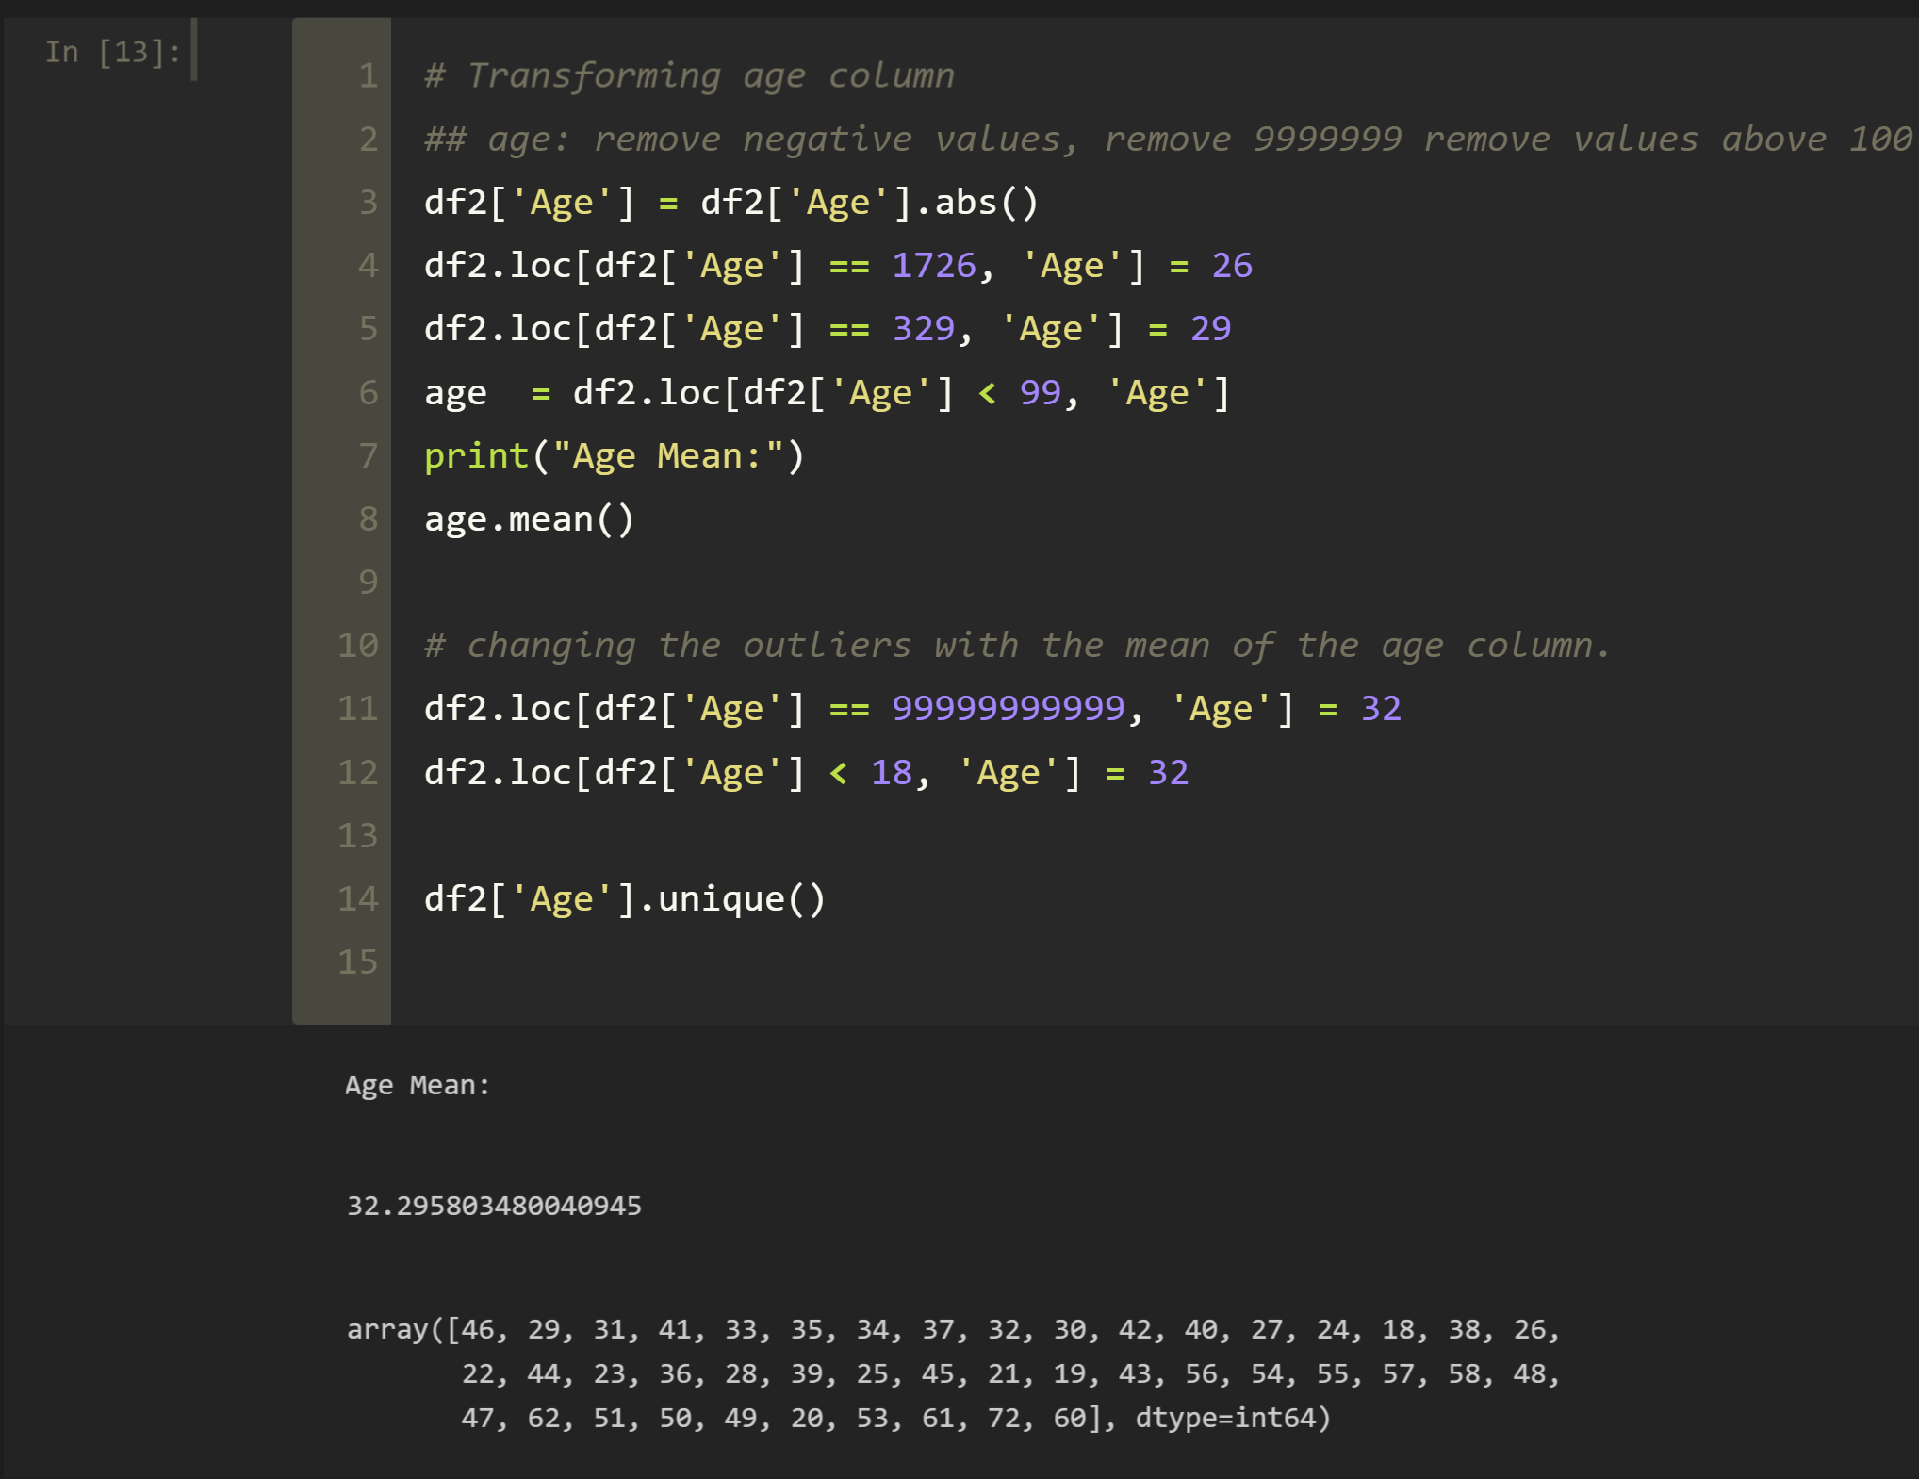
Age Column
We remove all negatives from the column.
Estimate what value could the outliers be
Put mean in places of some outliers that were found

Slide 32
Feature Engineering

Slide 33
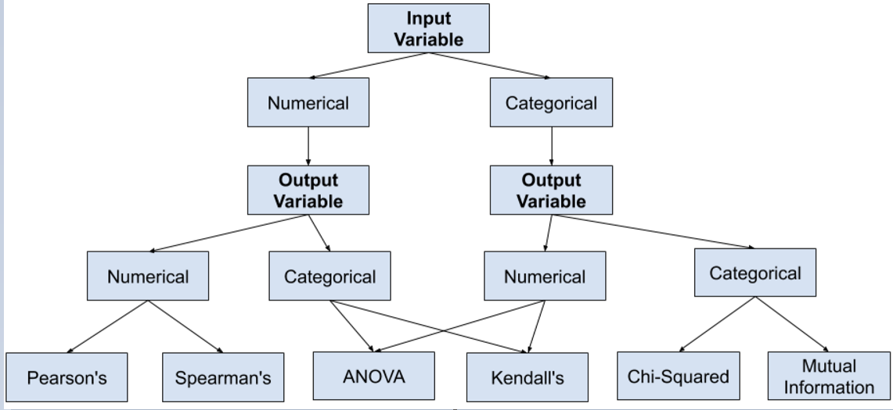
How to choose a feature selection method
Since we have categorical data Input and we have categorical data output we choose two methods to find out the relevant features
Chi-Squared
Mutual Information

Slide 34
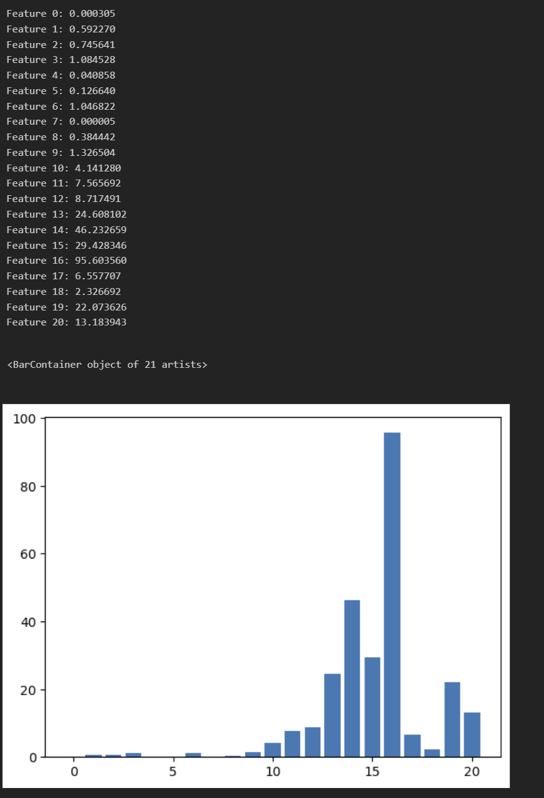
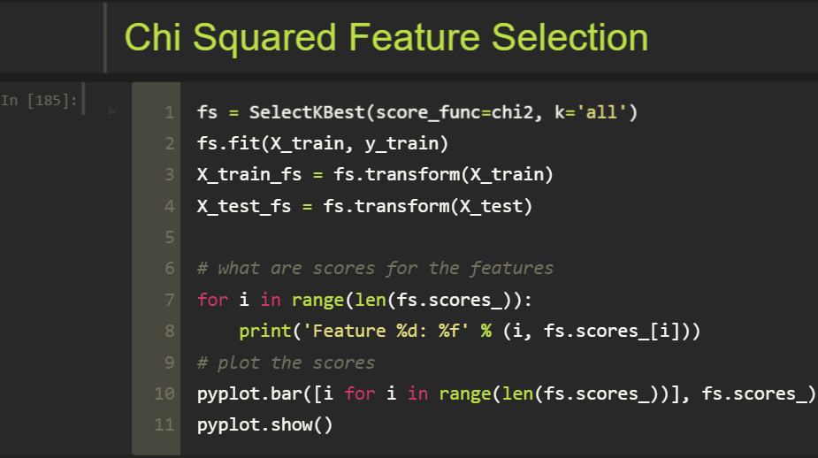
Feature Engineering using Chi2 Method
Histogram of feature relevance is plotted using chi square method
It looks like approximately 11 features are important according to Chi2 Method

Slide 35
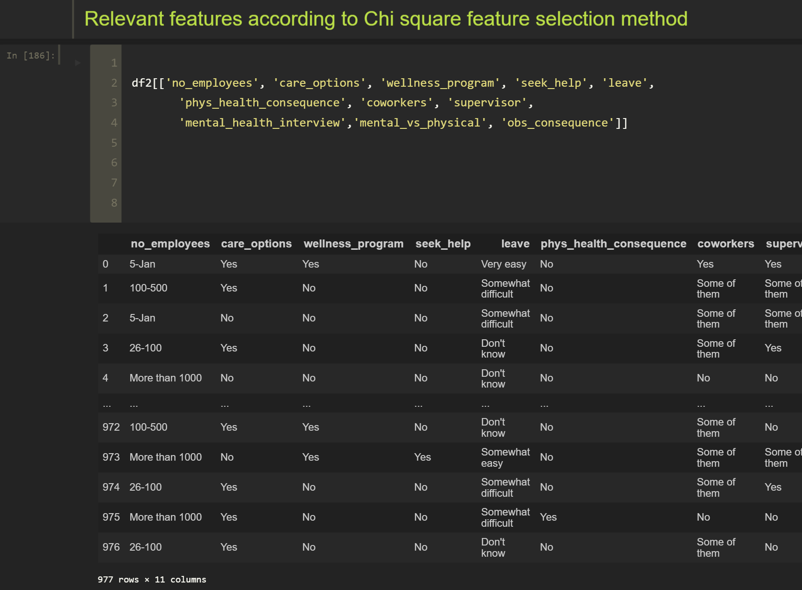
Features obtained using Chi2 method

Slide 36
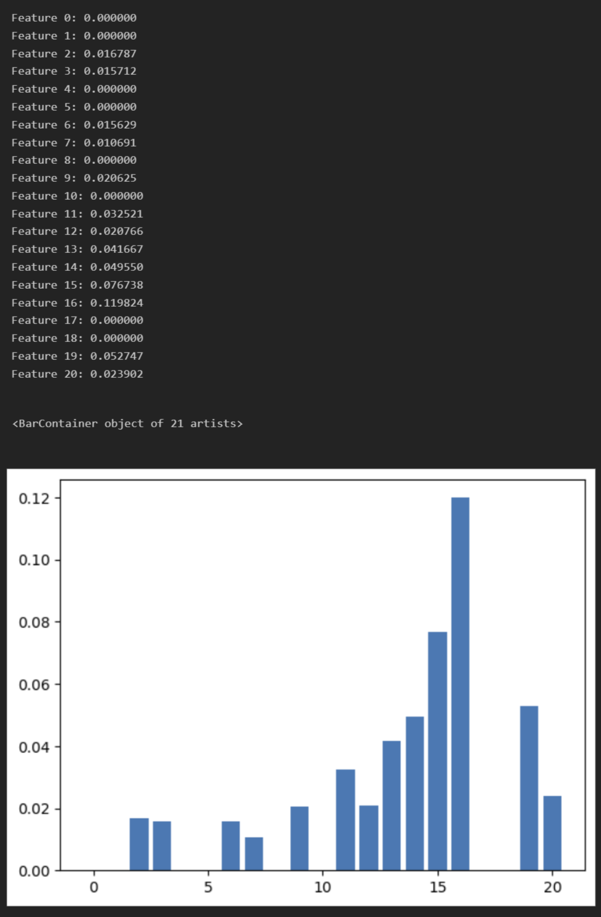
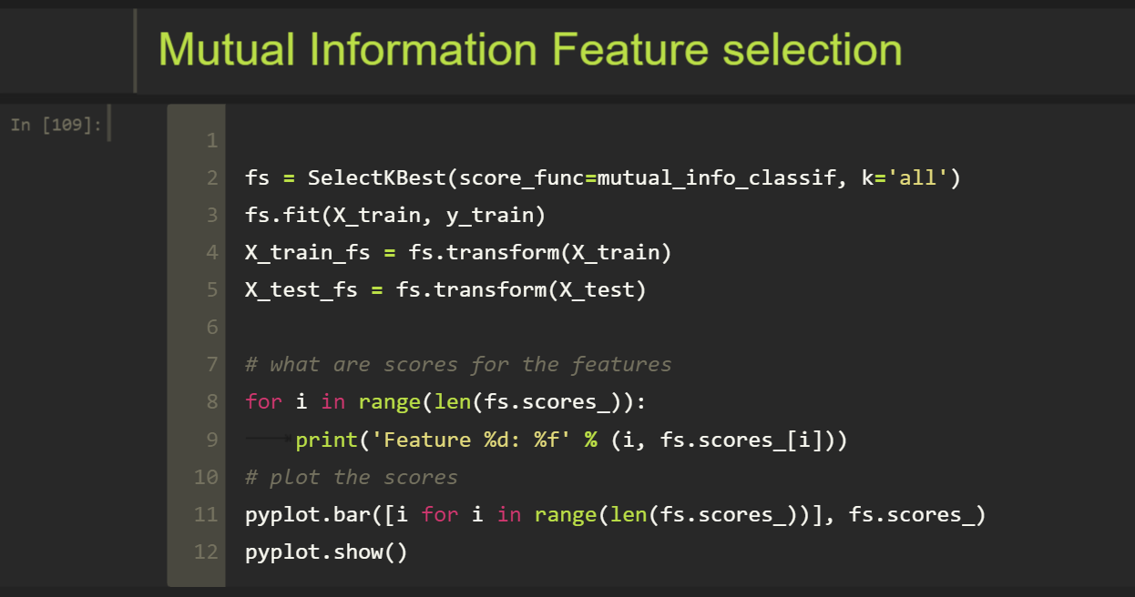
Feature Engineering using Mutual Information Method
Histogram of feature relevance is plotted using Mutual Information method
It looks like approximately 11 features are important according to Mutual Information Method

Slide 37
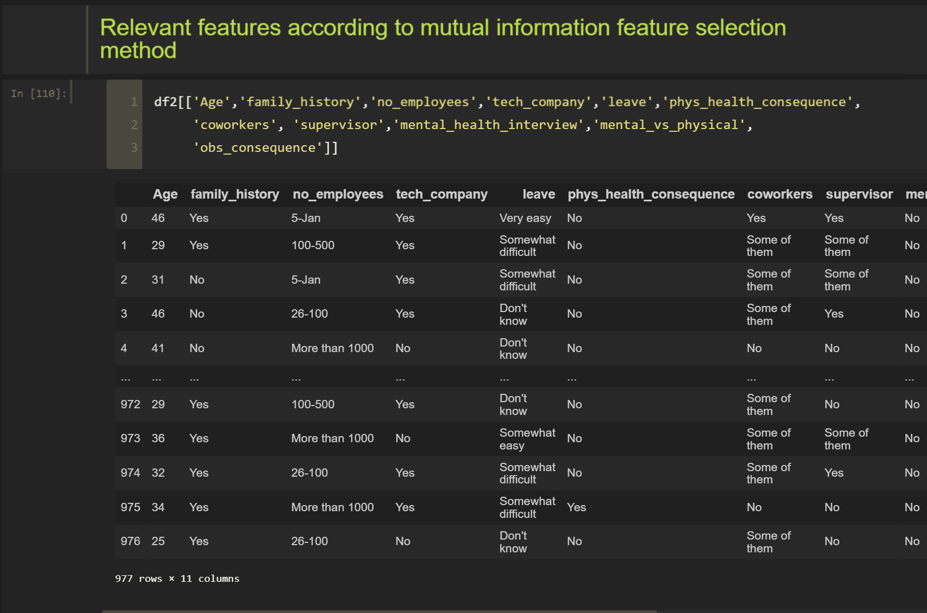
Features obtained using Mutual Information method

Slide 38
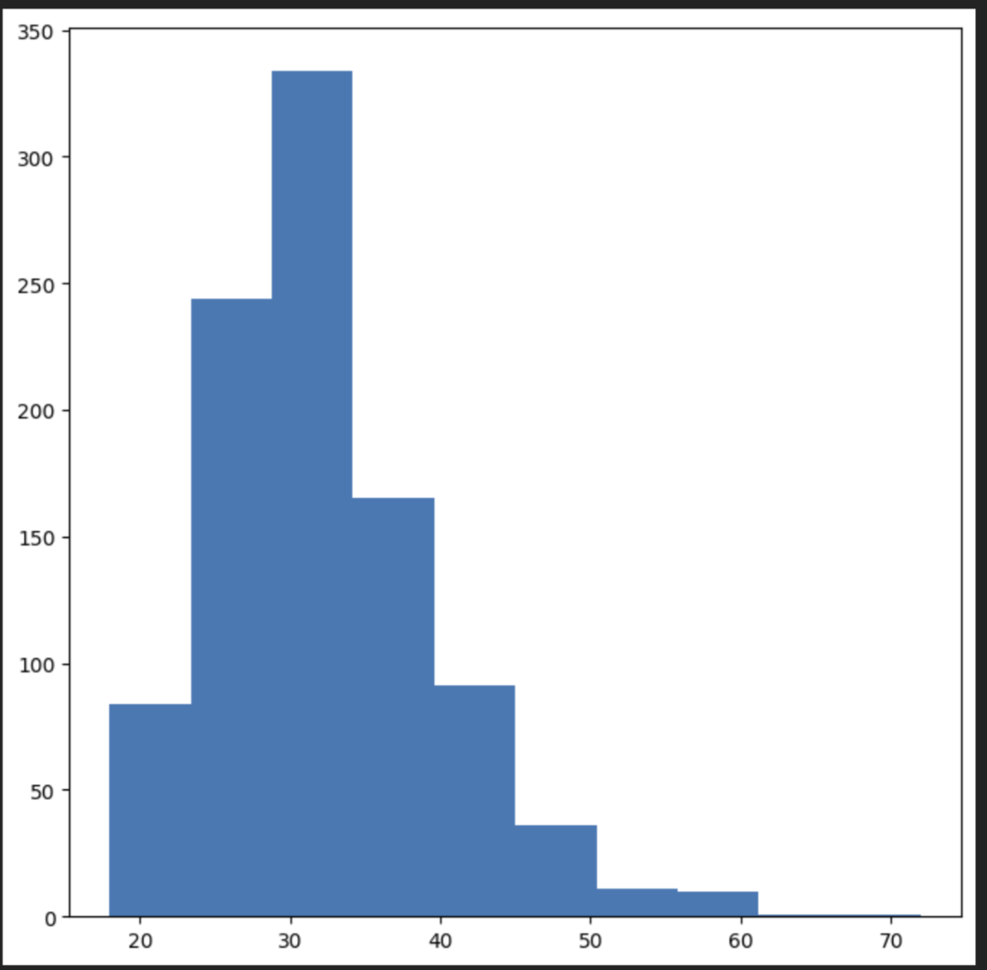
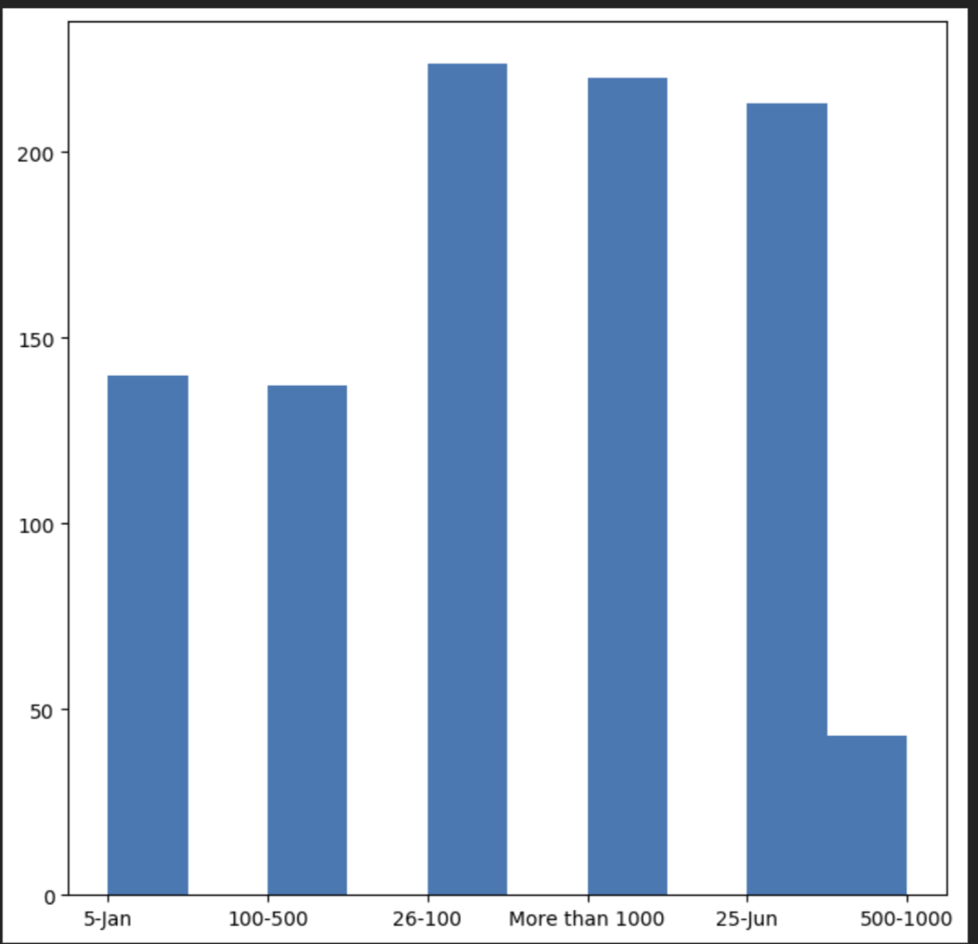
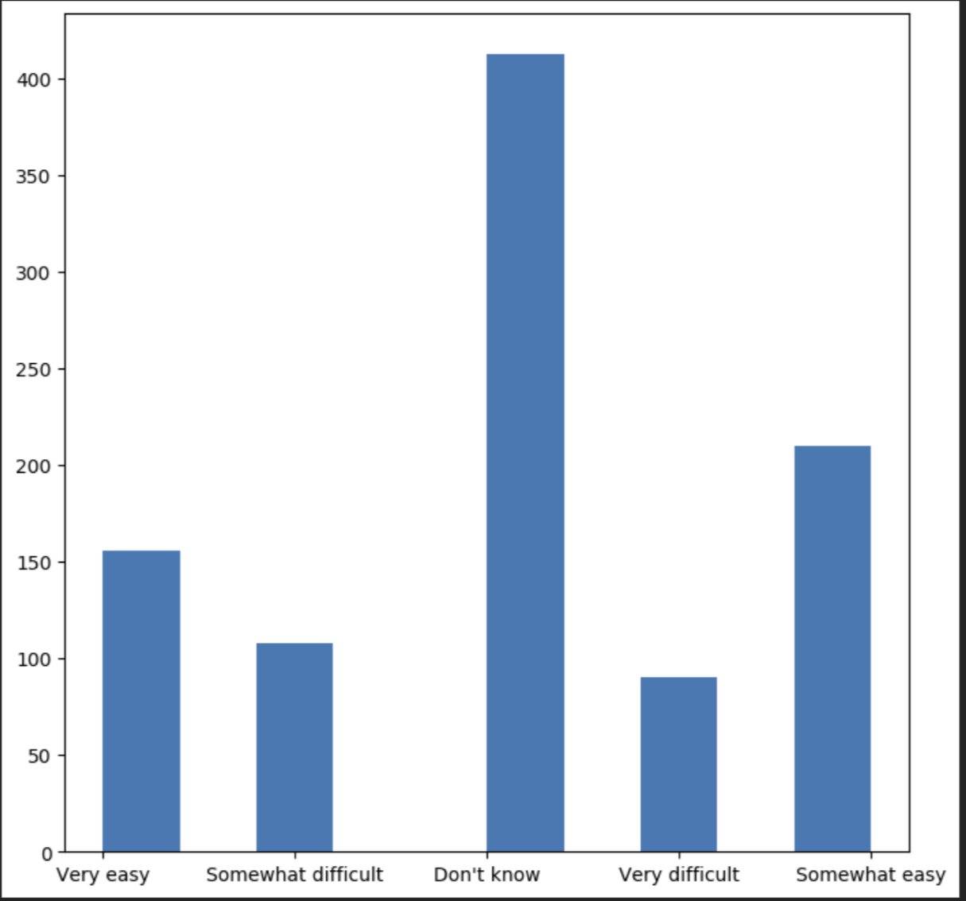
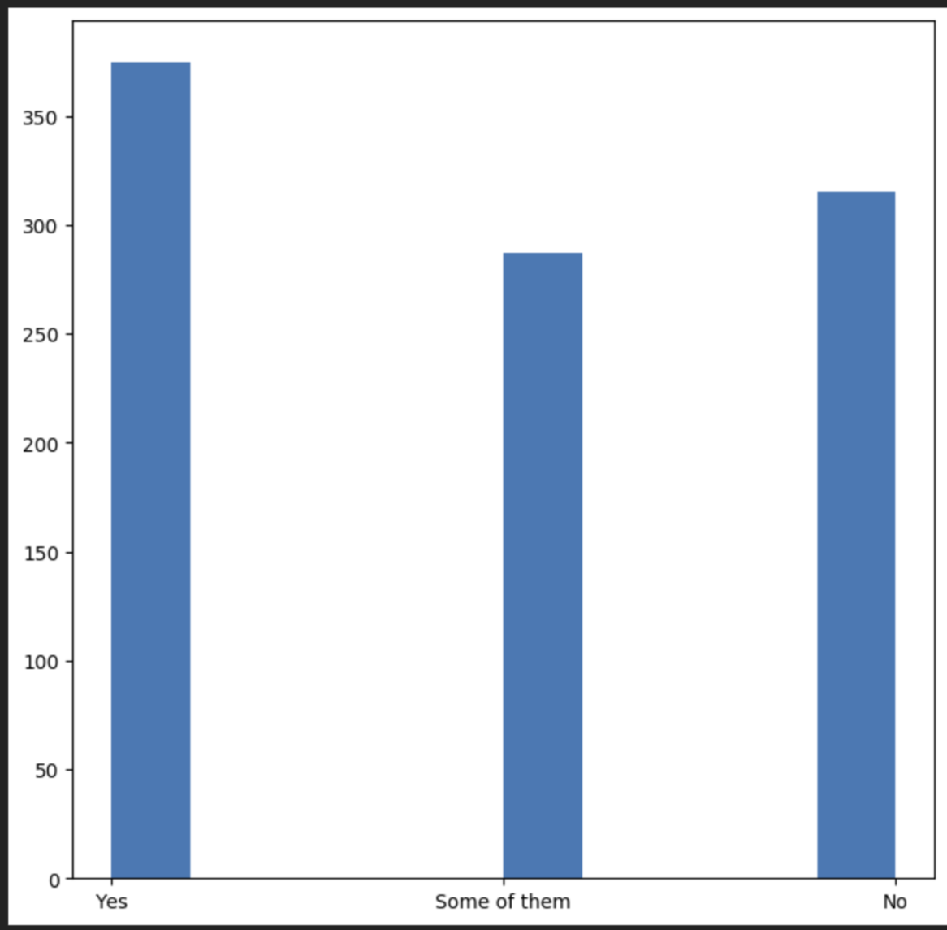
Histogram of few of the features that are important for modeling
Age
No of Employees
Leave
Supervisor

Slide 39
Model Building

Slide 40
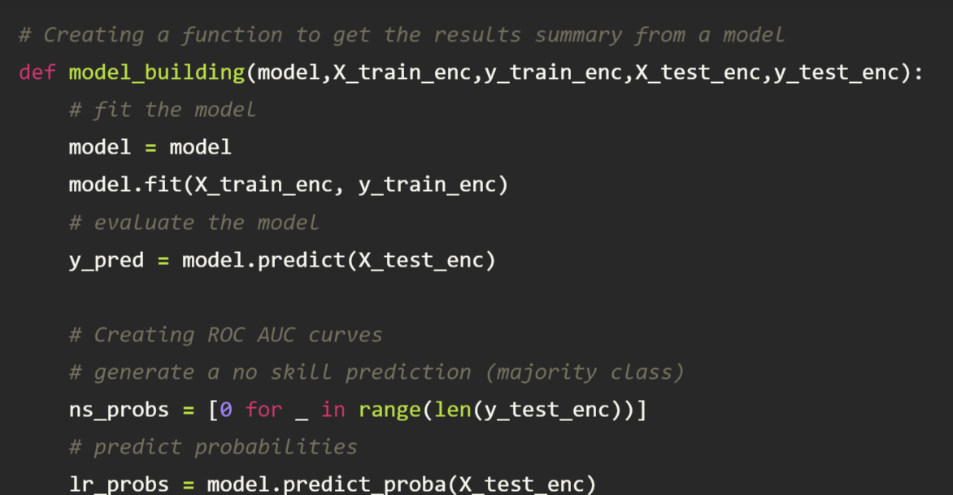
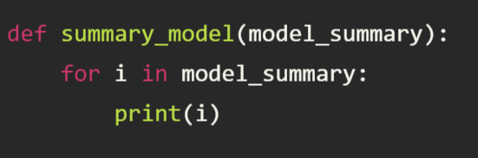
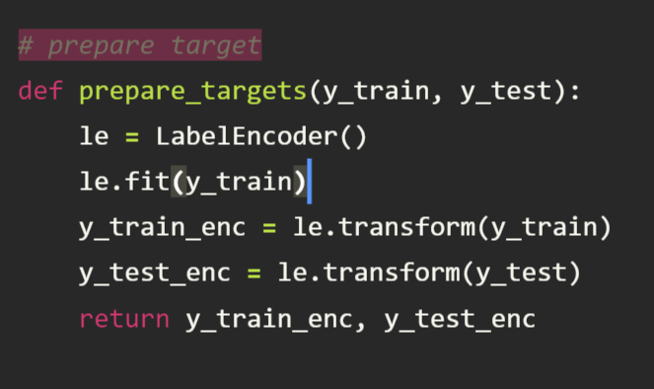
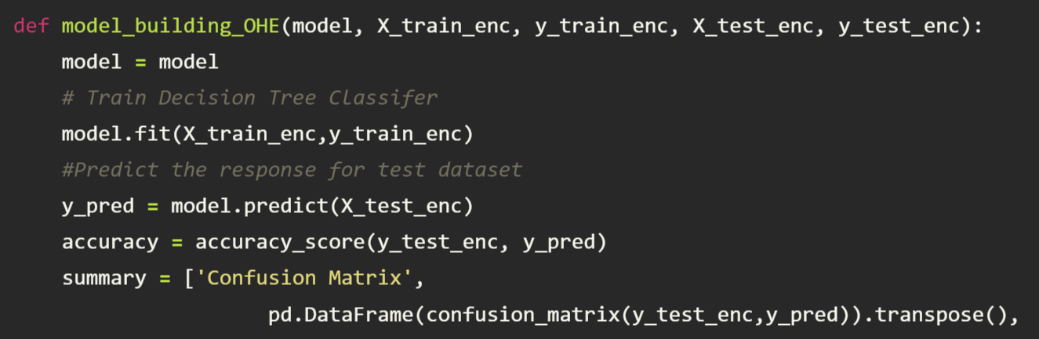
Building functions to build models and encode data appropriately
We built 4 functions to help us easily build and obtain summaries of models:
Model_building()
Summary_model()
Prepare_targets()
Model_building_OHE()
Chi2_feature()
MutualInformation_feature()

Slide 41
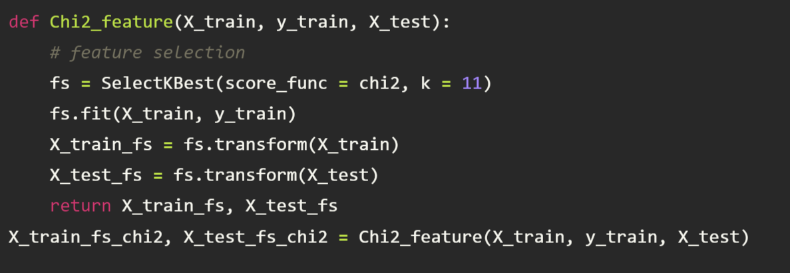
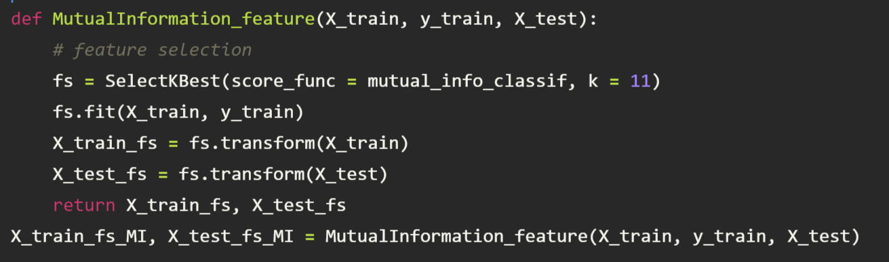
Models created
We have used these functions to create a total of 17 models. These models are as follows
Three Logistic Regression models (All features, Chi-square features and mutual information Feature)
Three Decision Tree models (All features, Chi-square features and mutual information Feature)
Three Random Forest models (All features, Chi-square features and mutual information Feature)
One SVM model (one hot encoded features and Chi-square features included)
One Neural Network (one hot encoded features and Chi-square features included)
Three Neural Networks (All features, Chi-square features and mutual information Feature)
Three Naïve Bayes model (All features, Chi-square features and mutual information Feature)

Slide 42
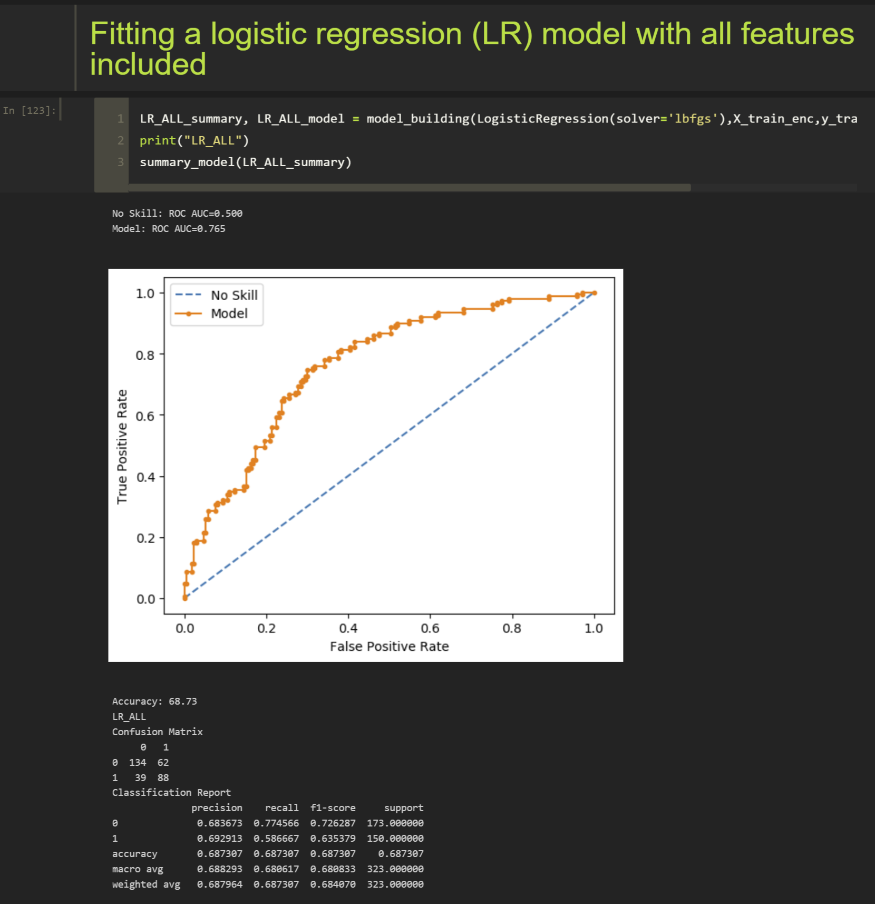
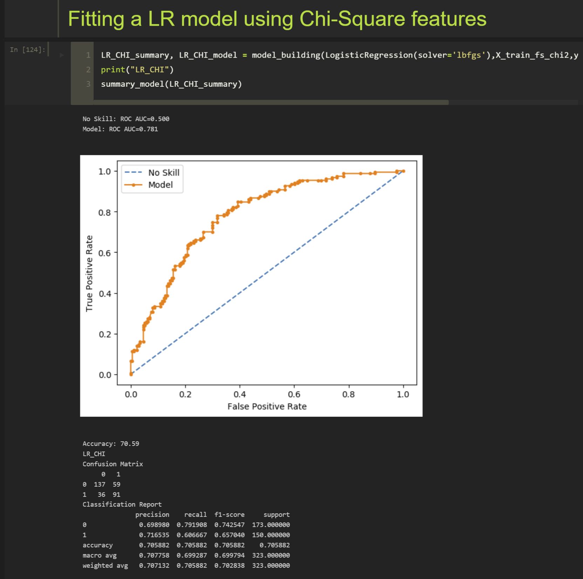
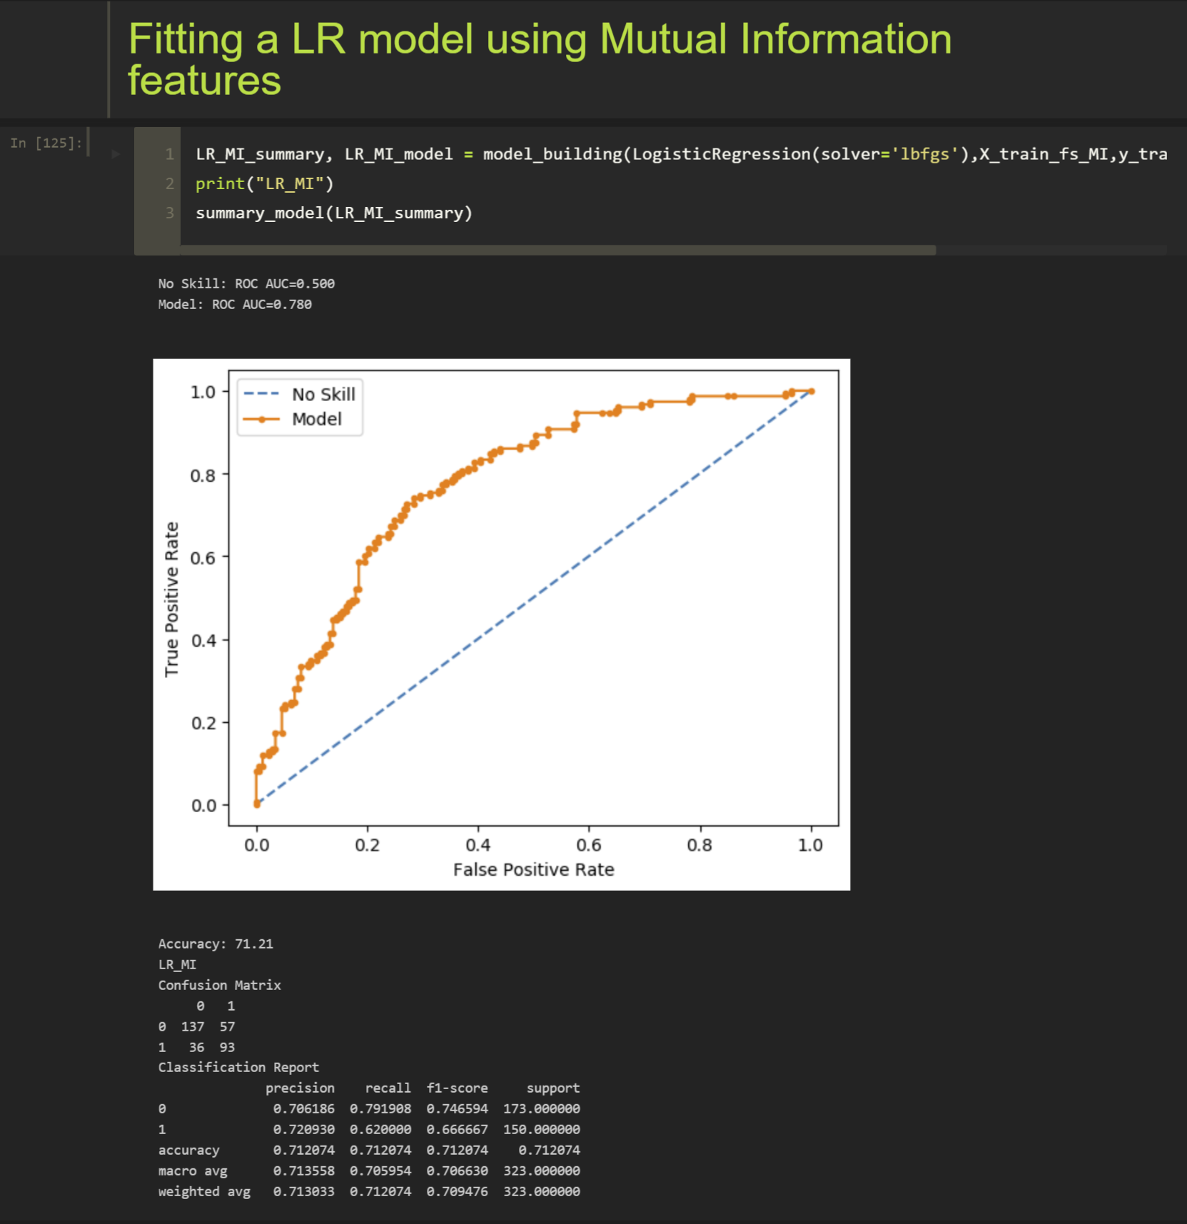
Importance of using feature engineering algorithms
Example of the three variants of Logistic Regression model with model summaries

Slide 43
Importance of using feature engineering algorithms
We can observe the model summary of the three models and see that the accuracy of the models increases if we use specific features obtained from feature engineering.
For logistic regression we can see that best results are obtained for a logistic regression model with Mutual Information features.
Model | Accuracy
Logistic Regression (All features) | 68.73%
Logistic Regression (Chi-Square features) | 70.59%
Logistic Regression (Mutual Information) | 71.21%

Slide 44
Sensitivity and Model Performance Analysis

Slide 45
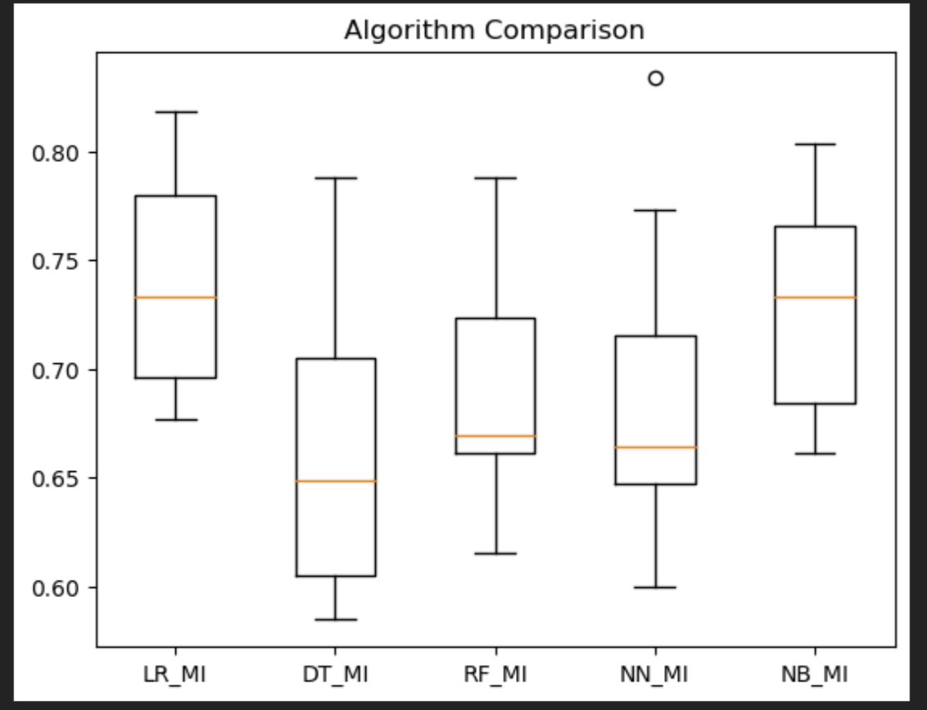


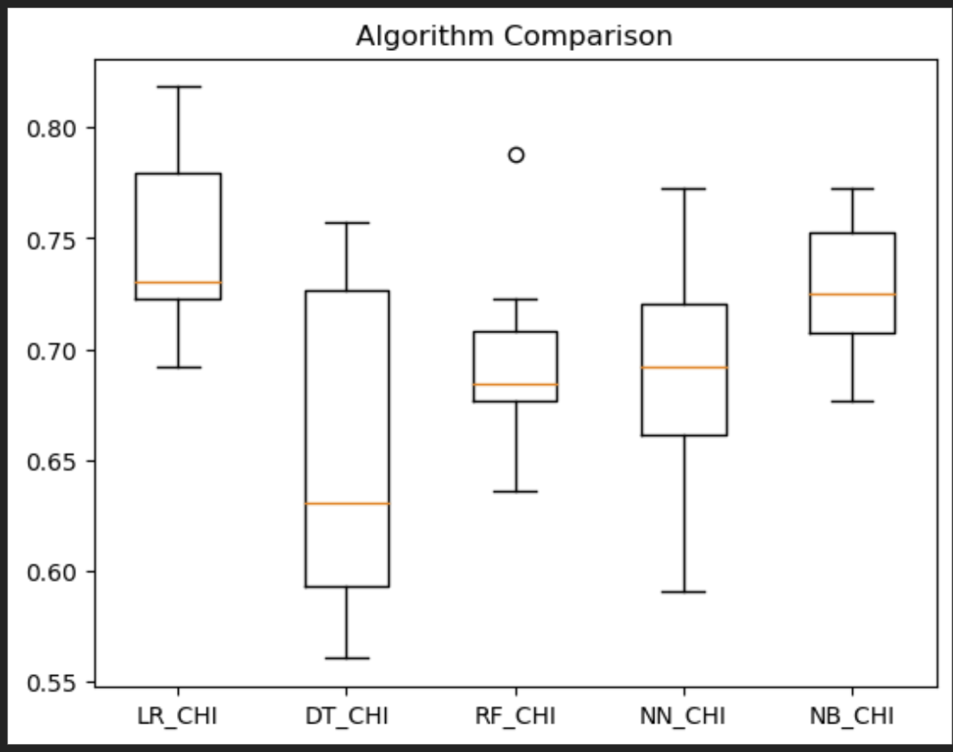
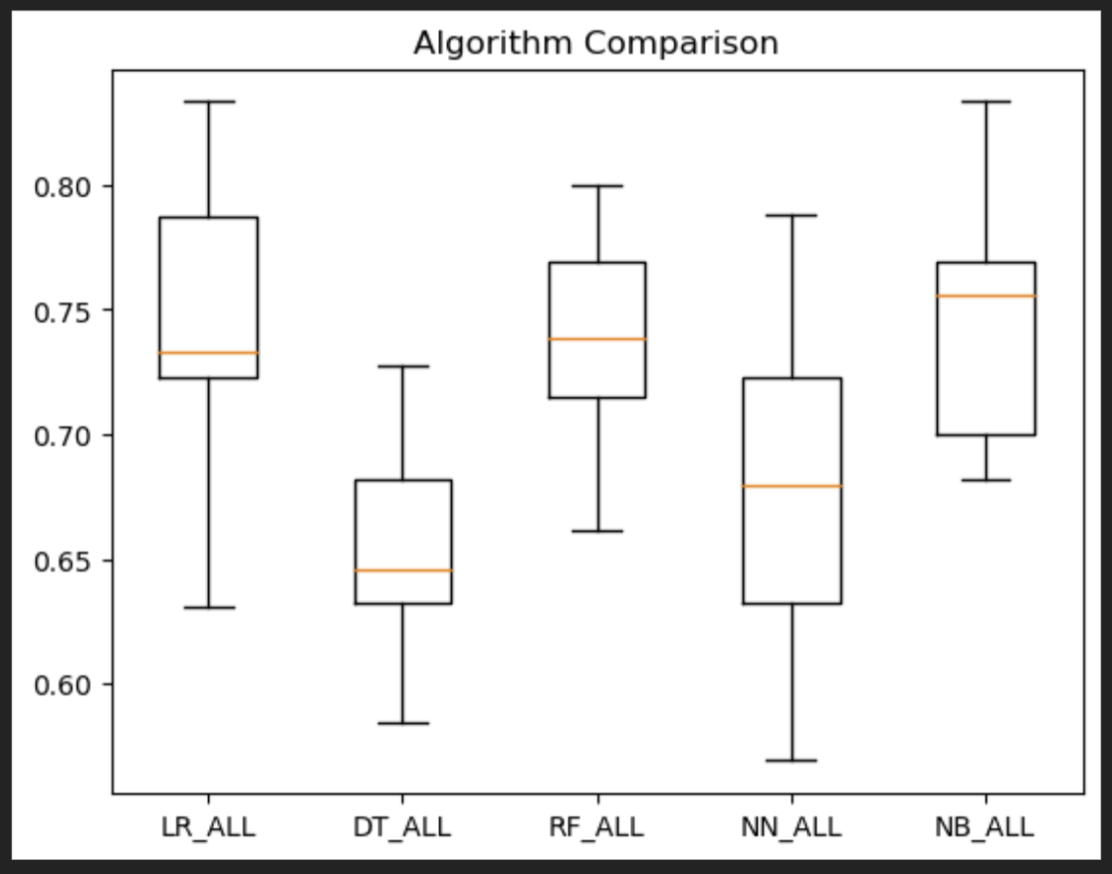
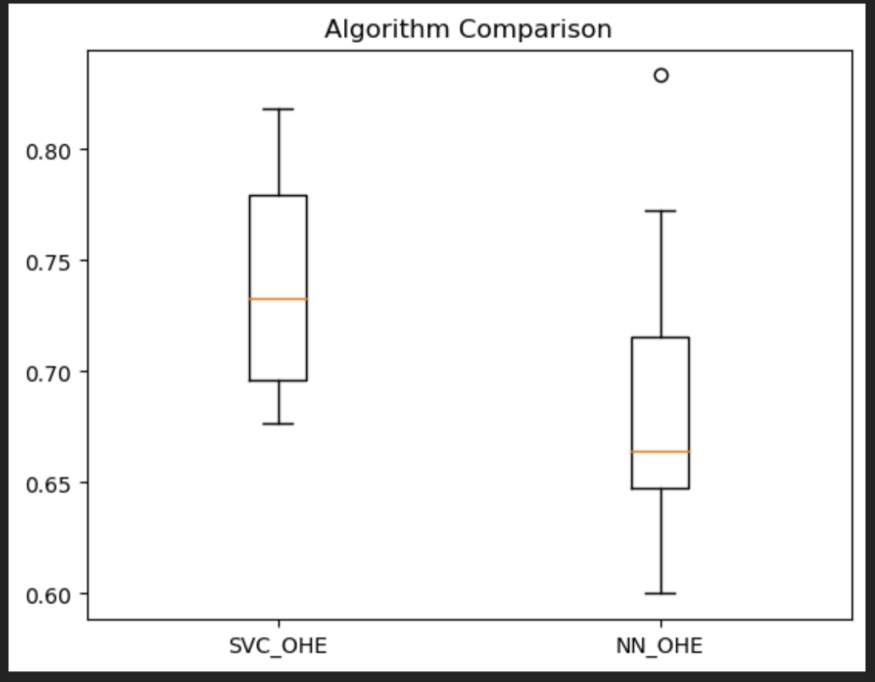
10-fold Cross validation
For sensitivity analysis we perform 10-fold cross validation on all the variants of the models.
The following boxplots were constructed using the accuracies of the models obtained from the validation.

Slide 46
Top Three Models

Slide 47
Metrics Analyzed
We analyzed our models with metrics such as:
Accuracy
Precision
Recall
F1 Score
ROC AUC score
Sensitivity analysis using 10-fold Cross validation
We arrived at the conclusion that:
Naïve Bayes model with mutual features included
Logistic Regression Model with mutual features included and
Support Vector Machine classifier with one hot encoding
Were the top three models to predict mental health consequence from the given dataset

Slide 48





Accuracy, Confusion Matrix and Classification Report summary of top three models
Naïve Bayes model with MI features
Logistic Regression model with MI features
Support Vector Machine with Chi2 features

Slide 49
Running best model on 10 random instances generated data

Slide 50


Creating the data frame with 10 random instances generated
We choose Logistic Regression with mutual information features as the best model based on our analysis.
We chose Mutual information features and created a data frame by generating 10 random instances.

Slide 51



Creating Predictions based on our best model
We encoded out newly generated data set and performed predictions over it.

Slide 52

Thank You

